Slide 2
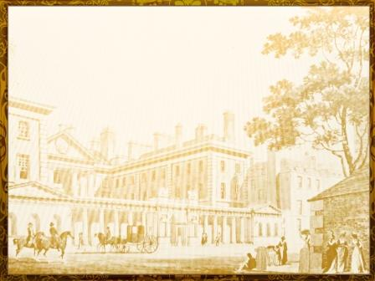
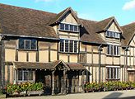
William Shakespeare is one of the greatest and most famous writers in the world. He was born on April 23, 1564 in Stratford-on- Avon. It was a small English town. His mother was the daughter of a farmer. His father was a glove-maker..
Shakespeare’s home

Slide 3
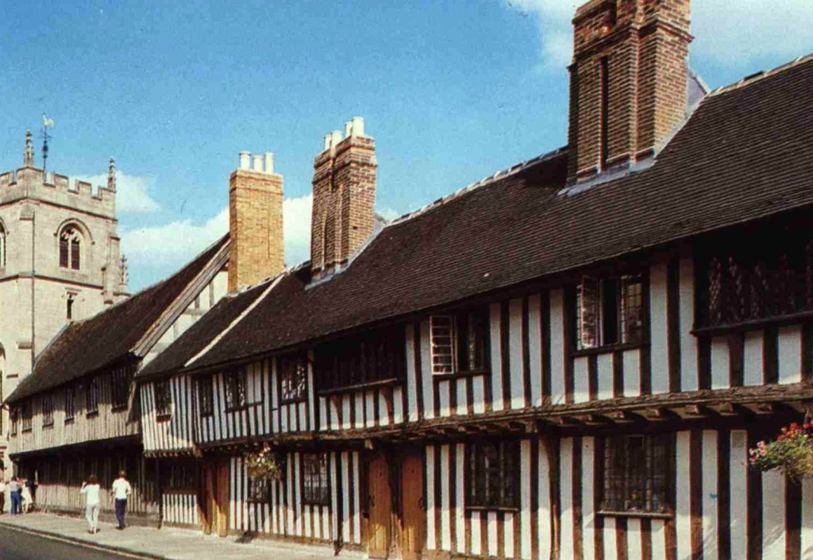
His father wanted his son to be an educated person and William at the age of 6 was sent to the local grammar school. He had no free time. When he had a break William liked to go to the forest and to the river Avon. He finished his studies at the age of 13 and never went to school again.
Shakespeare’s school

Slide 4
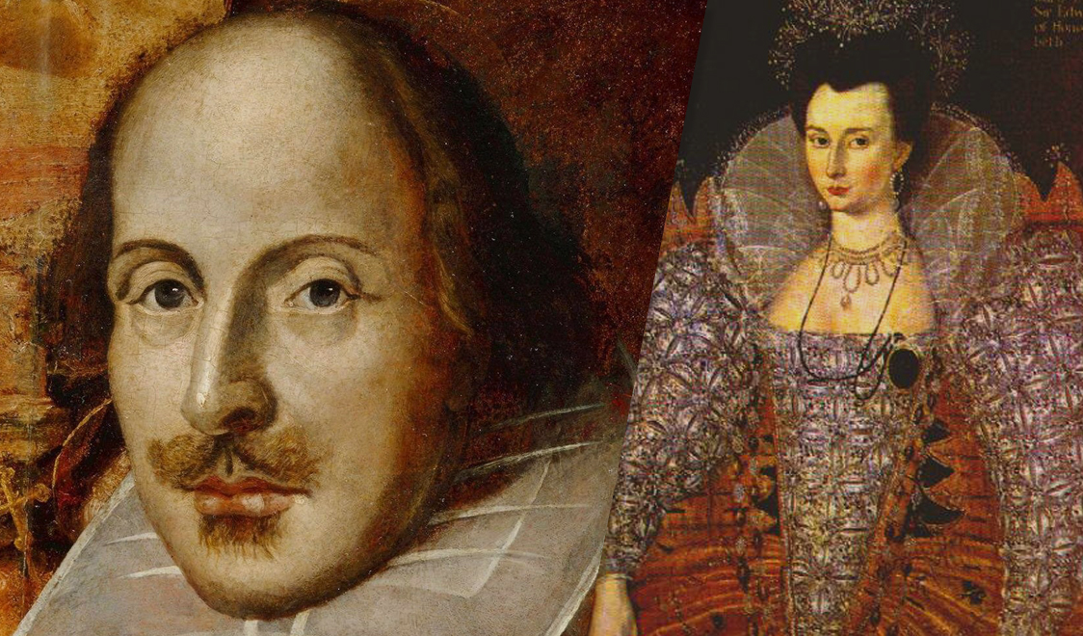
Being 18 years old, William married Anne Hathaway, who was 9 years older than himself. They had a daughter Susanna and twins – son Hamnet and daughter Judith.

Slide 5
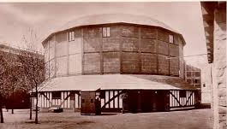
William could read and translate Latin books. He was fond of English folk-songs and ballads. When William’s father became poor he was 21 and William went to London and began to write his poems and plays at that time. He began to work in the modern theatre “The Globe”. In 1599 William became a part owner of the Globe Theatre in London.
The First Globe Theatre

Slide 6
Write true or false and correct follow sentences
1. W. Shakespeare was born on May
2. W. Shakespeare was born in Stratford-on- Avon
3. He studied at artist school
4. His father was a dress-maker
5. At the age of 6 he was sent to school
6. He didn’t like to go to the river Avon
7. He finished his studies at the age of 13
8.William married at the age of 18
9. His wife’s name was Cleopatra
10. They had three children
11. He couldn’t read and translate Latin books
12. He worked in the theatre “The Globe”

Slide 7
Self cheсking
1. W. Shakespeare was born on May F
2. W. Shakespeare was born in Stratford-on- Avon T
3. He studied at artist school F
4. His father was a dress-maker F
5. At the age of 6 he was sent to school T
6. He didn’t like to go to the river Avon F
7. He finished his studies at the age of 13 T
8.William married at the age of 18 T
9. His wife’s name was Cleopatra F
10. They had three children T
11. He couldn’t read and translate Latin books F
12. He worked in the theatre “The Globe” T

Slide 8
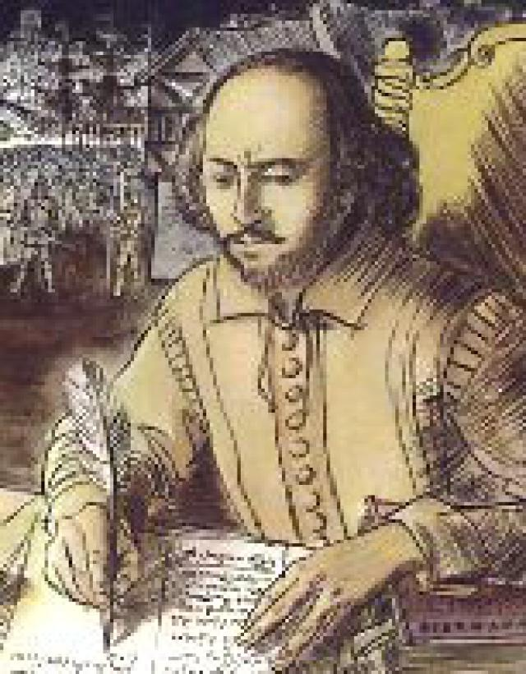
Shakespeare wrote 37 plays:
- 17 comedies
- 10 historical plays
- 10 tragedies
- 154 sonnets
But only 18 of them were published in his life time.

Slide 9
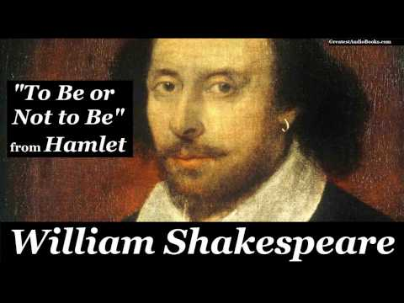
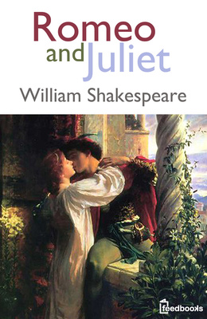
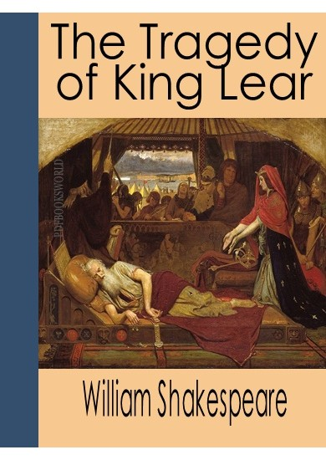
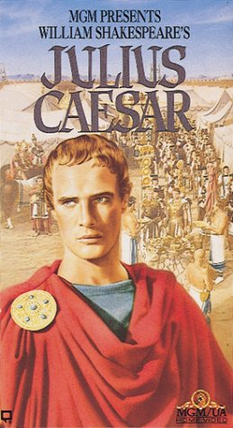
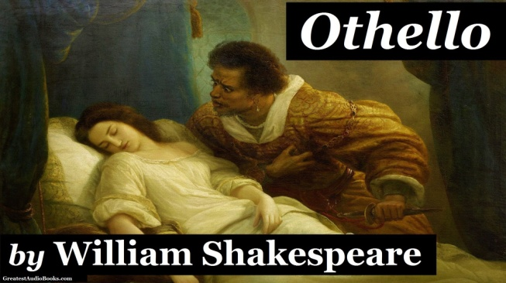
Tragedies
1. “Antony and Cleopatra”
2. “Coriolanus”
3. “Hamlet”
4. “Julius Caesar”
5. “King Lear”
6. “Macbeth”
7. “Othello”
8. “Romeo and Juliet”
9. “Timon of Athens”
10. “Titus Andronicus”

Slide 10
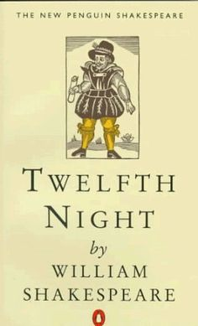
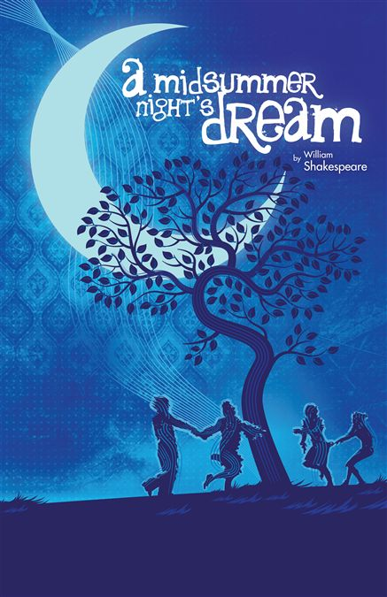
Comedies
1. “All’s Well That Ends Well”
2. “As You Like it”
3. “Cymbeline”
4. “The Comedy of Errors”
5. “Love’s Labour’s Lost”
6. “Measure for Measure”
7. “The Merchant of Venice”
8. “The Merry Wives of Windsor”
9. “A Midsummer Night’s Dream”
10. “Much Ado About Nothing”
11. “Pericles, Prince of Tyre”
12. “The Taming of the Shrew”
13. “The Tempest”
14. “Trolius and Cressida”
15. “The Two Gentlemen of Verona”
16. “Twelfth Night”
17. “The Winter’s Tale”

Slide 11
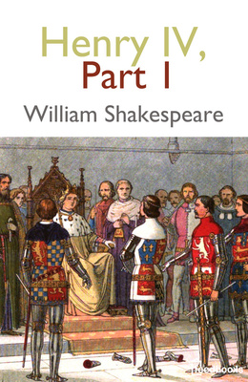
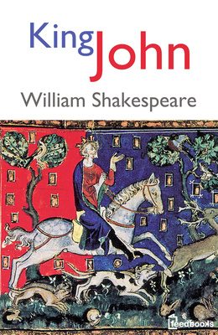
Histories
1. “Henry IV, Part 1”
2. “Henry IV, Part 2”
3. “Henry V”
4. “Henry VI, Part 1”
5. “Henry VI, Part 2”
6. “Henry VI, Part 3”
7. “Henry VIII”
8. “King John”
9. “Richard II”
10. “Richard III”

Slide 12
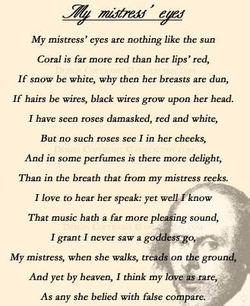

Slide 13
Її очей до сонця не рівняли, Корал ніжніший за її уста, Не білосніжні пліч овали, Мов з дроту чорного коса густа. Троянд багато зустрічав я всюди, Та на її обличчі не стрічав, І дише так вона, як дишуть люди, А не конвалії між диких трав. І голосу її рівнять не треба До музики, милішої мені, Не знаю про ходу богинь із неба, А кроки милої цілком земні. І все ж вона – найкраща поміж тими, Що славлені похвалами пустими.

Slide 14
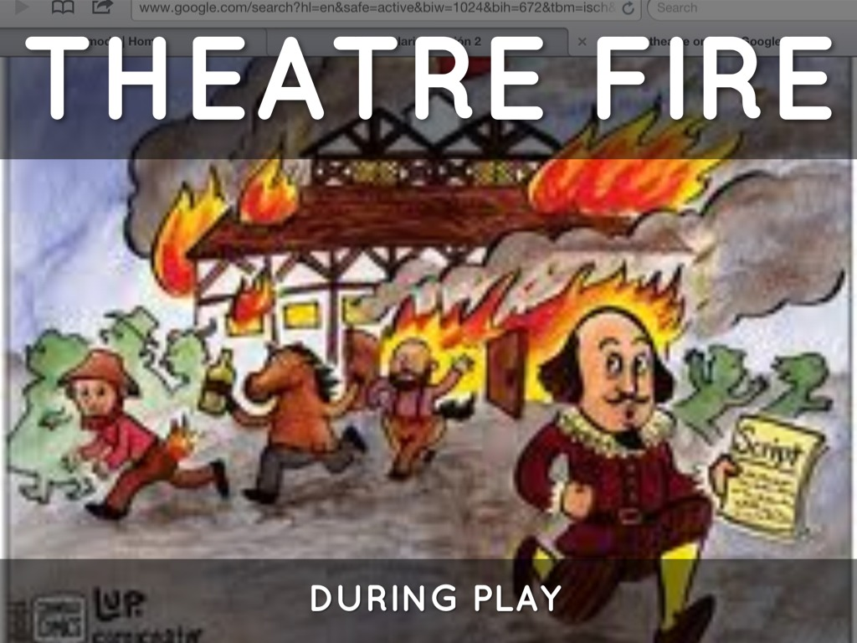
After the fire had destroyed the Globe during the performance of Henry VIII he retired to Stratford and stopped writing altogether.

Slide 15
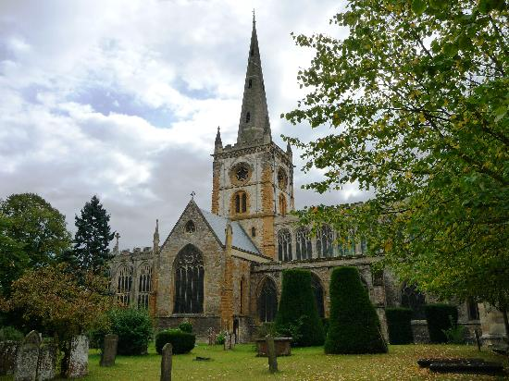
He died, on the same date as his birthday, the 23rd of April 1616. He was buried in the church of Stratford.

Slide 16
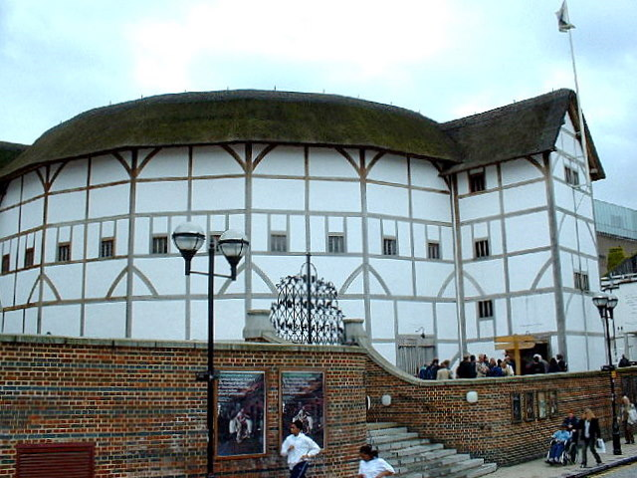
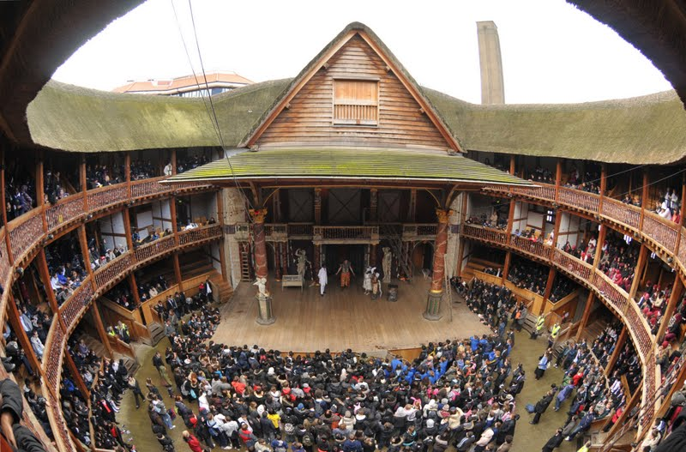
The new Globe Theatre opened in London in 1997, which looks the same as the one in which Shakespeare worked. The people on the main floor stand in front of the stage, just as the people did in Shakespeare's time. There is a Shakespeare museum in Stratford-on- Avon.

Slide 17
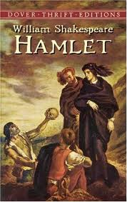
Many centuries have passed since his death, but Shakespeare is still considered to be the greatest of all playwrights and poets. His plays are still acted in the whole world

